Slide 1

University of Central Florida COP 3330 Object Oriented Programming

Slide 2
Agenda
Administrative
Logger

Slide 3
Logger

Slide 4
Logger
Applications make logging calls on Logger objects
Loggers are organized in a hierarchical namespace and child Loggers may inherit some logging properties from their parents in the namespace
These Logger objects allocate LogRecord objects which are passed to Handler objects for publication
Loggers and Handlers may use
logging Levels
Filters to decide if they are interested in a particular LogRecord
When it is necessary to publish a LogRecord externally, a Handler can use a Formatter to localize and format the message before publishing it to an I/O stream

Slide 5
Logger
Each Logger keeps track of a set of output Handlers
By default all Loggers also send their output to their parent Logger
Loggers may also be configured to ignore Handlers higher up the tree

Slide 6
Log Levels
Each log message has an associated log Level
The Level gives a rough guide to the importance and urgency of a log message
Log level objects encapsulate an integer value, with higher values indicating higher priorities
The Level class defines seven standard log levels

Slide 7
Log Levels
The levels in descending order are
SEVERE (highest value)
WARNING
INFO
CONFIG
FINE
FINER
FINEST (lowest value)
Additionally there is
OFF that can be used to turn off logging
ALL that can be used to enable logging of all messages

Slide 8
Log Levels
OFF is a special level that can be used to turn off logging
SEVERE is a message level indicating a serious failure
WARNING is a message level indicating a potential problem
INFO is a message level for informational messages
CONFIG is a message level for static configuration messages
FINE is a message level providing tracing information
FINER indicates a fairly detailed tracing message
FINEST indicates a highly detailed tracing message
ALL indicates that all messages should be logged

Slide 9
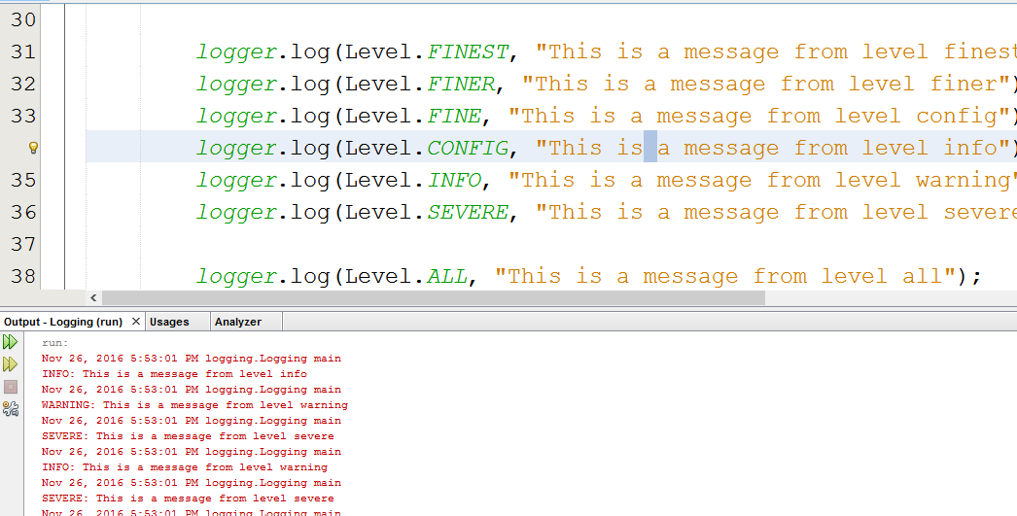
Runtime
Where are my messages?

Slide 10
Log Levels
Both the logger and its handlers have Log Levels
The order of filtering is Logger then Handlers
That means it checks to see if the log message passes the loggers filter first, then sends the message on to the individual handlers for filtering

Slide 11
Log Levels
OFF is a special level that can be used to turn off logging
SEVERE is a message level indicating a serious failure
WARNING is a message level indicating a potential problem
INFO is a message level for informational messages
CONFIG is a message level for static configuration messages
FINE is a message level providing tracing information
FINER indicates a fairly detailed tracing message
FINEST indicates a highly detailed tracing message
ALL indicates that all messages should be logged

